Slide 1

Python! Day 2
Comments (single line and double line)
Naming conventions for variables (ie. Snake case and Camel case)
String, int, float (gentle introduction to the concept of datatypes and data)
Importance of string int and float (python treats them differently)
String addition vs ”number” addition
Functions
Why functions are useful
Simple Calculator Project

Slide 2
Warm-Up
Write a program that asks for the user’s name and tells them “Good Morning” + name
For example: If the user’s name is Aaron, the program should print
Good Morning Aaron
Hint: use the input() and print() functions

Slide 3
Declaring Variables - Numbers
So far, our variable boxes have only held words, but they can hold things like numbers too
Let’s try this by creating a variable called weight
To create a variable that is a number instead of a word, we can write
weight = 20
Notice that we don’t put “ “ around the 20. We only put “ “ around words, not numbers

Slide 4
Printing Numbers
We can also print numbers using the print function
Try writing:
print(2)
without “ “ and see what happens
Because 2 is a number, not a word, we don’t need to put “ “ around it
This also works with variables containing numbers
Try writing:
number = 20
print(number)

Slide 5
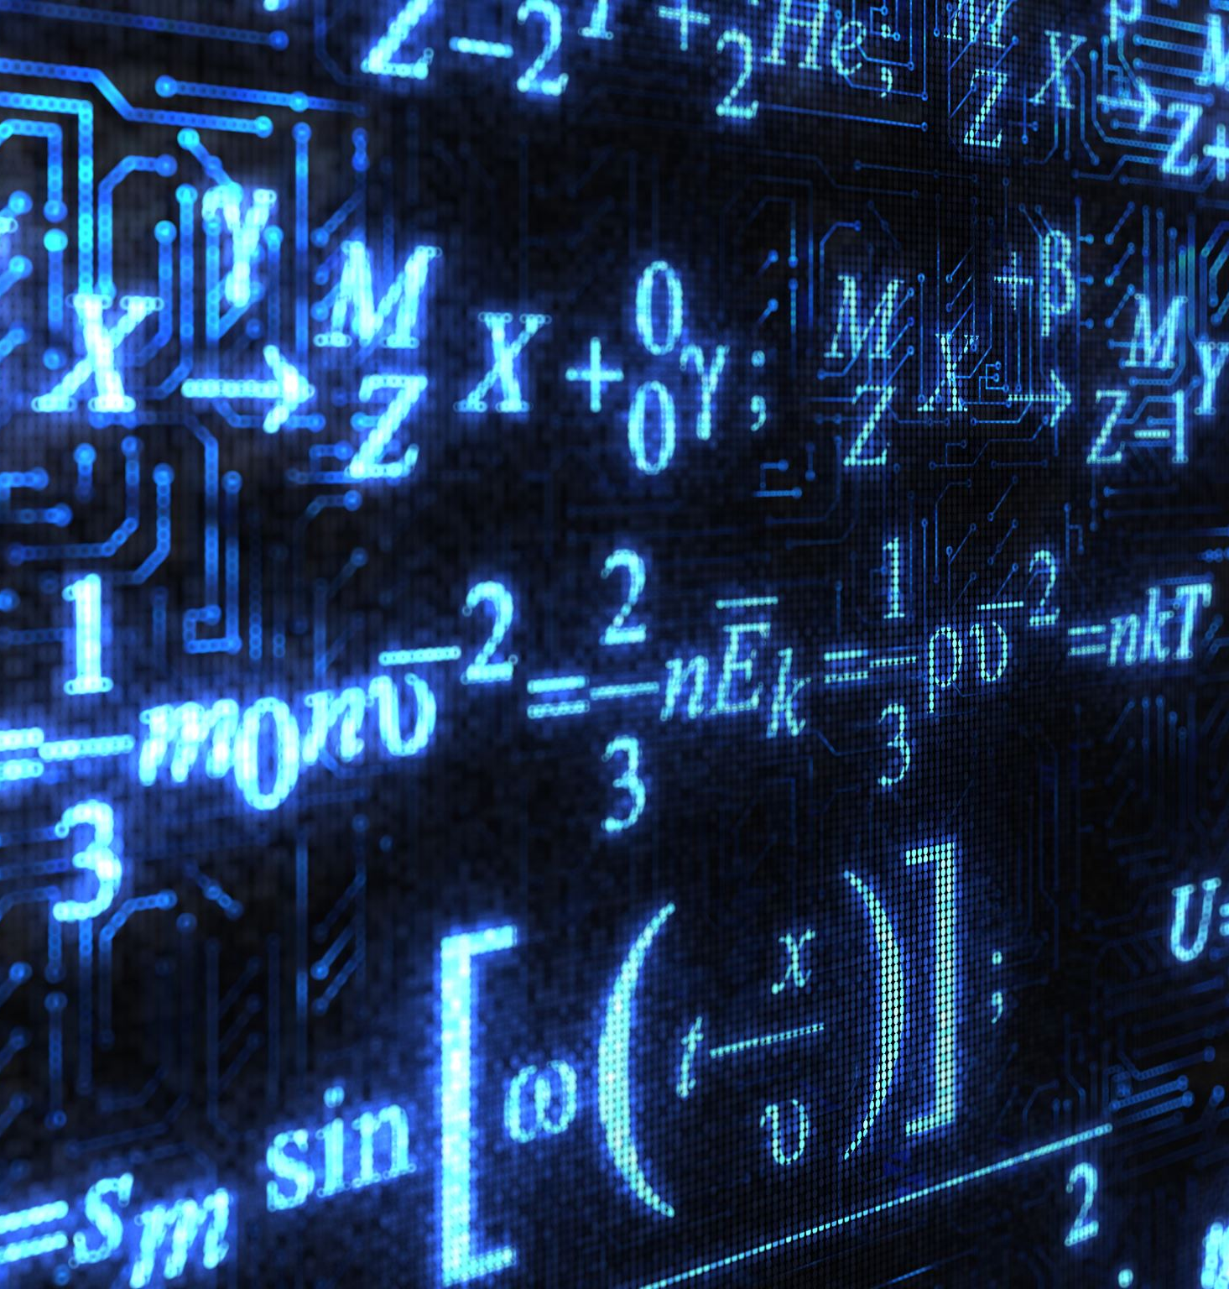
Using Numbers
One thing that computers are really good at is math.
The first-ever computers were made to solve math problems
Let’s get the computer to do some math using numbers
Write:
print(20 + 3)
print(297 + 536 – 761 + 1082)

Slide 6
Adding Words vs. Adding Numbers
Notice that saying
print(2 + 3)
does something different than saying
print(“2” + “3”)
Try it out
When we add numbers, it prints the sum of the numbers but when we add words, it sticks one word to the end of the other

Slide 7
Operators
Things like addition or subtraction are done with + and –, which are operators.
There are 5 main operators in Python:
Addition: +
Subtraction: -
Multiplication: *
Division: /
Modulo: % (This one is complicated. We’ll talk about it later)

Slide 8
Comments
Comments are made using #
Ex: #this is a program is a comment
Comments are not read by the program. They are ignored
They are meant for the programmer or anyone reading your code
Comments are very useful and help you understand your own code
You can also surround code with ‘’’ ‘’’ to make it into a comment
Ex:
‘’’ These
Lines are now
Comments ‘’’

Slide 9
Simple Calculator
Here is a simple project:
Create a simple calculator that can add, subtract, divide, and multiply two numbers
Use variables for the numbers
a = 30
b = 20
print(a + b)
print(a – b)
print(a * b)
print(a / b)

Slide 10
Data Types
Variables can be words. Ex: name = “Raymond”
Variables can be whole numbers. Ex: age = 10
Variables can be numbers with decimal points. Ex: height = 35.6
Variables can be true or false values. Ex:
tuesday = true
Variables can be other things as well, but we will get to those later
For now, lets only look at words “strings”, whole numbers “ints”, and numbers with decimal points “floats”

Slide 11
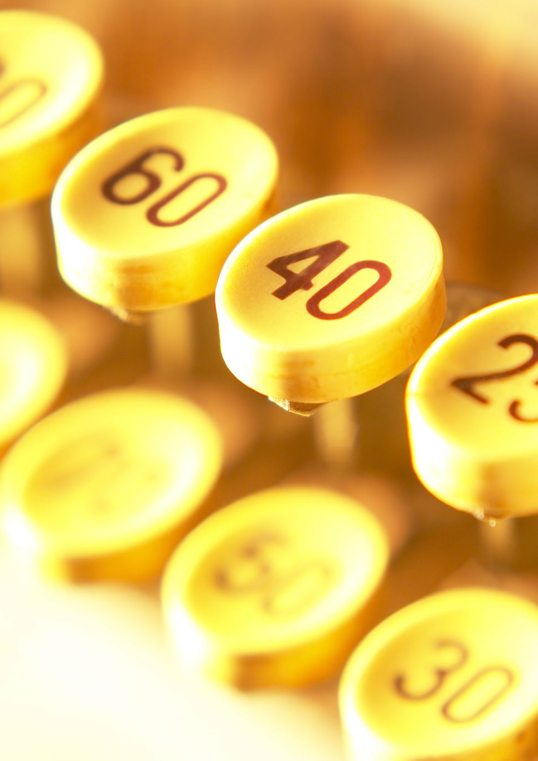
Data Types - Numbers
Numbers in Python come in two different flavors:
Numbers can be whole numbers that include negative numbers and zero
Ex: 2, 0, -9
Numbers can be with decimals that can also be negative or zero
Ex: 2.5, 0.00, -9.82751724

Slide 12
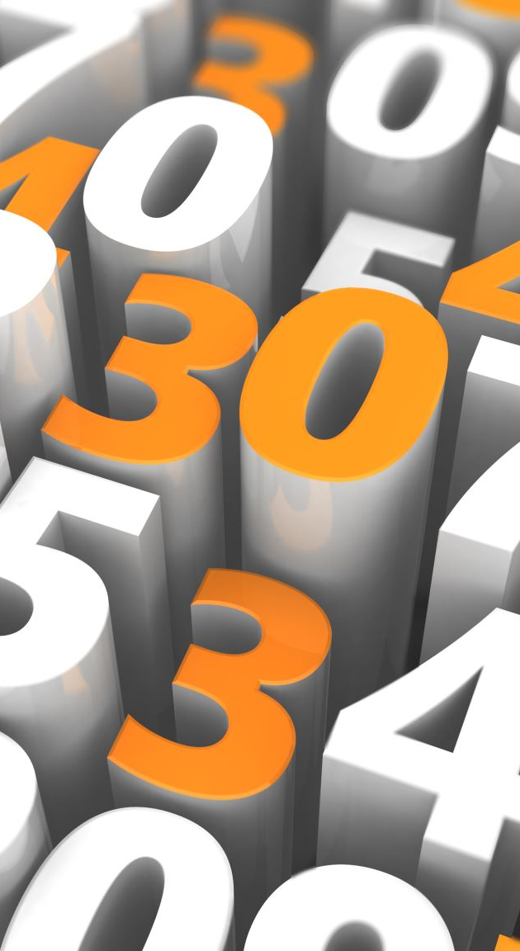
Int
Int stands for integer. These are whole numbers, or numbers without decimal points
When writing a program, we always want to use int when possible. Large software industries prefer int. They save memory space, are easy to work with, and can save time (GIANT programs like games need a lot of time to compile and energy)
Example of an int:
a = 30
b = 60

Slide 13

Float
Numbers with a Decimal are called float (which is short for floating point number)
These take up more space and are harder for the computer to use but are useful if something needs a decimal number
Ex: Decimals are needed to represent your height if you are 4.5 ft tall
Examples of floats are:
Weight = 3.45
Distance = 7.98
Volume = 3.00
Size = 0.00

Slide 14

String
Strings are words, but they don’t have to be real words
Examples of Strings are:
Name = “Raymond”
Message = “Hello, how is everyone doing today”
My_Favorite_Fruit = “Mango”
RandomStuff = “94382634823uhgfri2%^#@$(@*$#^”
Strings must be enclosed in “ “ or ‘ ‘
And an empty string is “”
Strings don’t have to be real words. They can be anything, as long as they appear in double or single quotes

Slide 15

Boolean
Booleans are something that is either true or false
Ex: itsTuesday = true
This makes sense because it is true that today is Tuesday
Ex: itsWednesday = false
This makes sense because today is not Wednesday
This is useful if we want a program to do something only if something is true
For example: If itsRaining = true, that means it is raining so maybe the program could tell the user to bring an umbrella

Slide 16
Other Data Types
Python has many different types of data
We will explore those later
We can also make our own data types
Int, Float, Boolean, and String are called primitive data types because they are basic and simple. There are all we need to know for now.
We can check what type a variable is using the type() function
Try writing
height = 3.5
print(type(height))

Slide 17
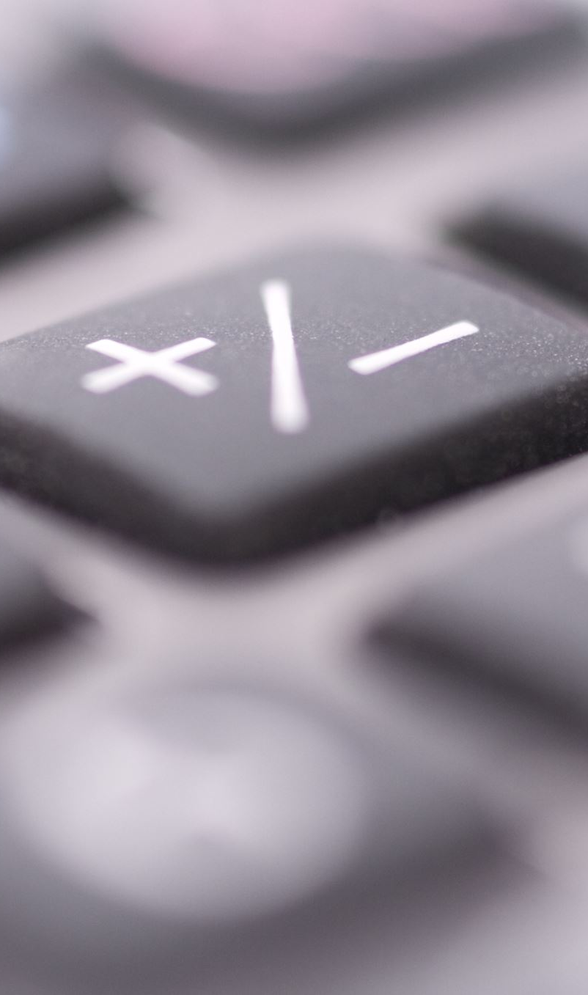
A Better Calculator
We can make a better calculator by getting the user to choose what values a and b are
But right now, if we try writing like that, it doesn’t work
Try it out:
a = input(“a = “)
b = input(“b = “)
print(a + b)
We can figure out what the problem is using the type() function
Write:
print(type(a))
print(type(b))

Slide 18
Now we can see that when we use input, it gives us a String variable. In other words, when the user says that a = 2, the program thinks 2 is a word, not a number.
We can fix this using something called type-casting
This is when we take a String to change it into an Int or a Float or change an Int into a Float or String, etc.
There are 3 Type-Casting Methods:
int() – Ex: number = int(“2”)
float() – Ex: decimal = float(“0.2”)
str() – Ex: word = str(2)
In this case we want to change a String into an Int, so we want to use int()

Slide 19
a = int(input(“a = “))
b = int(input(“b = “))
print(a + b)
print(a – b)
print(a * b)
print(a / b)

Slide 20
Naming Conventions
So, you might have noticed that I name my variables a little weird: I either name them like this: thisIsTheVariable or like this this_is_the_variable
These are the two commonly used ways to name things whose name is more than one word long
this_is_the_variable is called snake case and is most commonly used in Python
thisIsTheVariable is called camel case
These naming conventions make names in code easy to read
It doesn’t really matter which convention you use. Choose whichever you prefer

Slide 21
Functions
Functions allow us to group code together and reuse code
Think of functions as machines. A car takes in gas and drives
A function is an organized box of code that does something – whatever we tell it to
Functions make code easy to read and write
To create a function, we say:
def name_of_function():
# do this…
Then, to get that function to happen, we say:
name_of_function()

Slide 22
Functions – Our Program
We can use functions to neaten our program
What is in a function is indicated by how indented it is
Example of incorrect indentation:
def add_numbers():
print(1 + 2)
Example of correct indentation:
def add_numbers():
print(1+2)

Slide 23
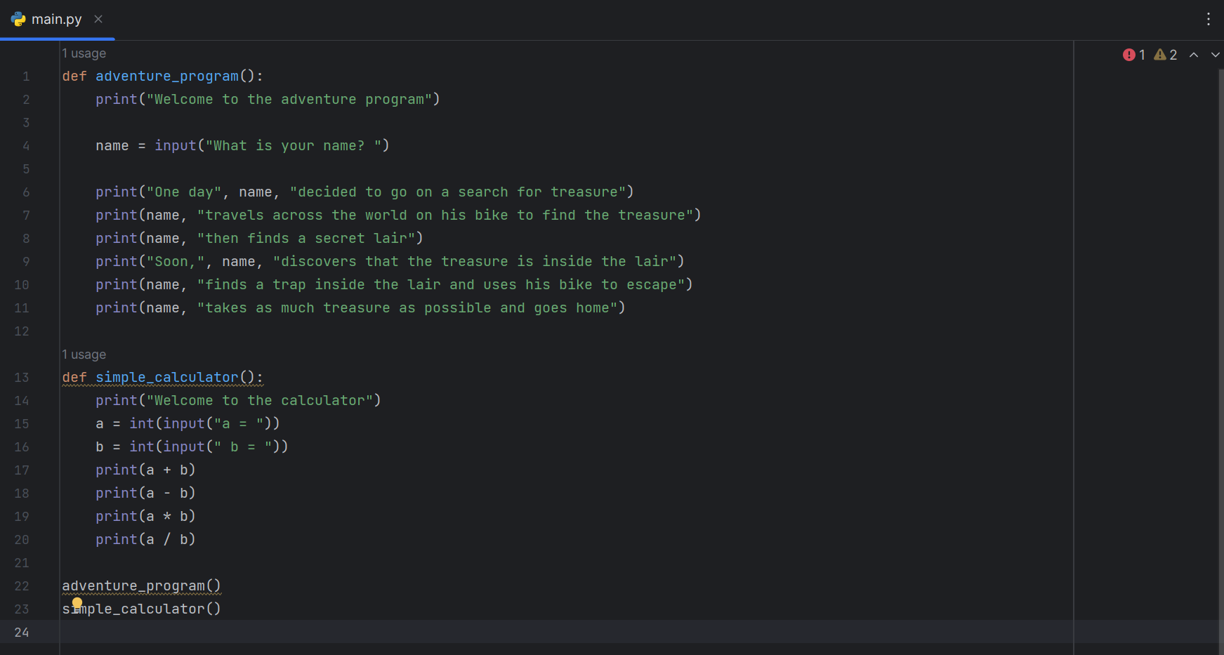

Slide 24

Now our code is organized, and we can use yesterday’s adventure program, today’s calculator, or both
We can also make the program repeat as much as we want
Try typing this underneath the functions:
adventure_program()
adventure_program()
adventure_program()
This is a super easy way to make our code repeat
It saves time and effort

